Slide 1
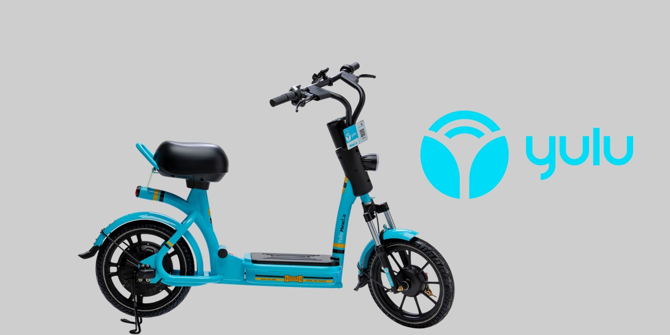
YULU BIKES PVT LTD
PRESENTED BY:
NAME : RASHMI NAIR

Slide 2
INTRODUCTION
YULU,a Bangalore-based electric bike and cycle sharing platform, was started by InMobi Co-founder Amit Gupta in 2017.
Electrical bikes(Yulu Miracle) and cycles (Yulu Move) are provided on rent.
Operating in Mumbai, Delhi, Bengaluru, Bhuwaneshwar.
In November 2019,YULU raised $8 million in its Series A round, from Bajaj Auto Finance. Existing investors invested an additional $2 million in YULU .
The team is looking to support over 1,00,000 Yulu Miracleby2020.
AIM: To address traffic problems and pollution.

Slide 3
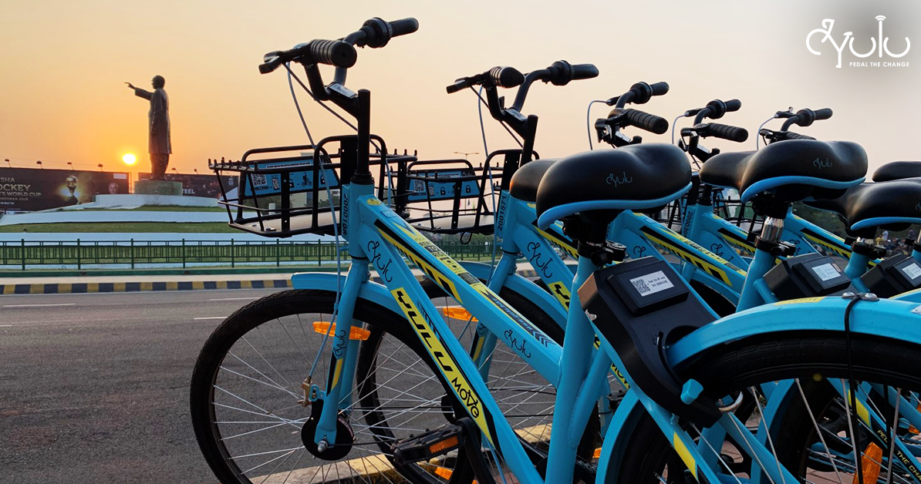
SCAN QR or Enter Registration number to unlock vehicle and ride
The customer scans QR code on the vehicle and the lock automatically opens.
When the customer scans the QR code , company sends info of the vehicle to the customer on app after which he/she unlocks the vehicle.
The company uses the information of the user’s phone. As soon as the user scans QR or enters vehicle no. ,the company comes to know about the location of the user which they use to trace where the vehicle is going.
They use AI and ML Techniques for this.
They have a big screen showing blue and red bubbles on map . Blue bubbles show the vehicles moving and red show the vehicles which are low battery.

Slide 4
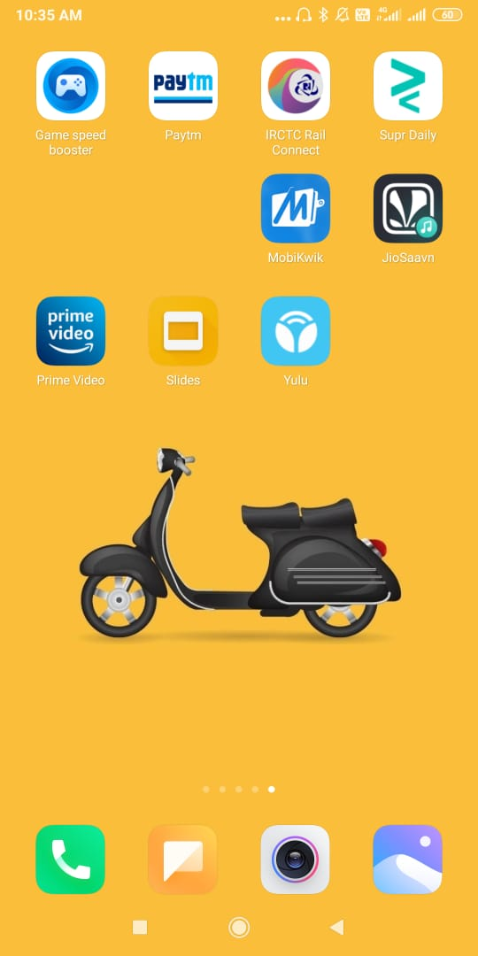
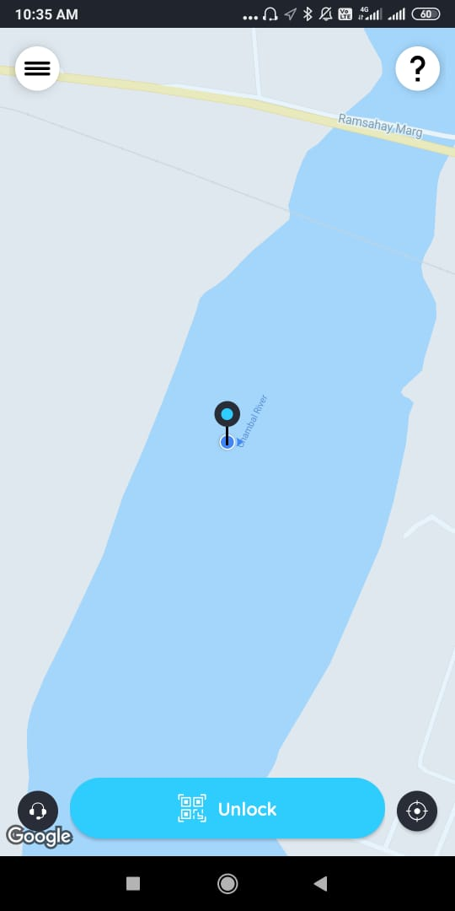
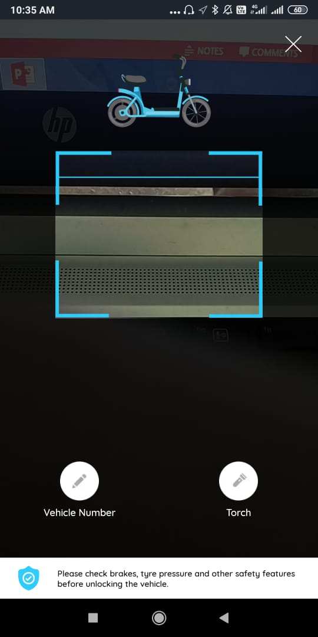
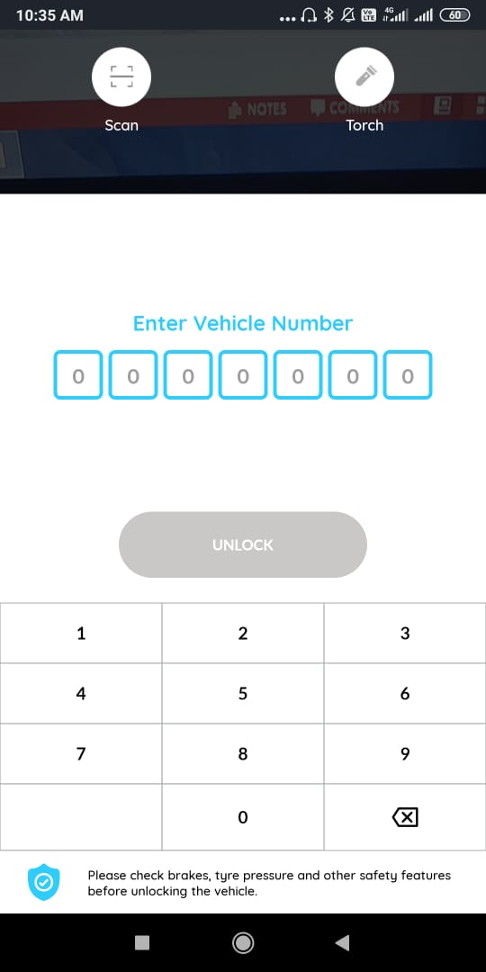
YULU APP INTERFACE
SCAN QR Code
OR Enter Vehicle No.

Slide 5
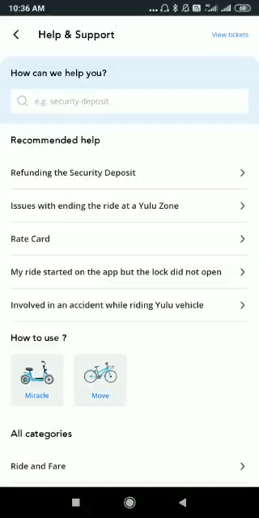
Please play the video on left STEPS TO RIDE a) YULU MOVE b) YULU MIRACLE

Slide 6
How I decided upon the data Points?
Installing and using Yulu App.
Browsing through YULU website.
Watching videos related to startup story of Yulu.
Understanding the complete procedure of how the business works.
Websites :
https://yourstory.com/2020/02/startups-electric-vehicles-ather-yulu
https://yourstory.com/2019/09/behind-scenes-yulu-electric-vehicles-ev-startups
https://startuptalky.com/yulu-success-story/

Slide 7
ER DIAGRAM

Slide 8
Raw Materials
Date
Bill No.
Supplier ID
ManufacturerID
Vehicle type ID
No. of Vehicles
Amount
Manufacturers
Manufacturer ID
Name
Contact No.
Email
City
Pincode
Manufacturer Transactions
Date
Manufacturer ID
Employee ID
Vehicle Type_ID
No. of vehicles
Vehicle Reg.No.
Customers
Customer ID
First Name
Last Name
Mobile Number
Address
City
Email ID
Vehicle Type
Vehicle Type_ID
Name
YULU OFFICE
Selects
supply
Employees
Employee ID
Dept Name
First Name
Last Name
Gender
Mobile Number
Email ID
Address
City
Country,pincode
YULUMIRACLE_Details
Vehicle_type_ID
Deposit_Amount
Unlock_charges
Subsequent_10min_charges
waiting_charges
Number of vehicles
YULUMOVE_details
Vehicle_Type_ID
Deposit_Amount
Cost_First_30_min
Cost_subsequent_30_min
waiting charges_every_30_min
Number of vehicles
Supplier Details
Supplier ID
Name
Address
Email
Contact no.
City
Country
Order Details
Date
Order no.
Supplier ID
Employee ID
Vehicle Type _ID
No. of Vehicles
TO
Orders
Billing & Riding details
Date
Ride No.
Customer ID
Vehicle Type ID
Vehicle Reg. No.
Start Time
Waiting Time
End Time
Distance Covered
Start location
End Location
Total Amount
pymt
Payroll
EmployeeID
Dept name
Name
Salary
picks
Maintenance details
Vehicle Type ID
Vehicle Reg No.
Battery Available
GPS_Location
Vehicle_Picked
Customer_ID
Vehicle_type_ID
Vehicle Reg. No.
QR code
YULU WALLET
Customer ID
Vehicle type ID
Payment mode
Security Amount
Balance
Rides

Slide 9
DATA TABLES AND ENTRIES

Slide 10
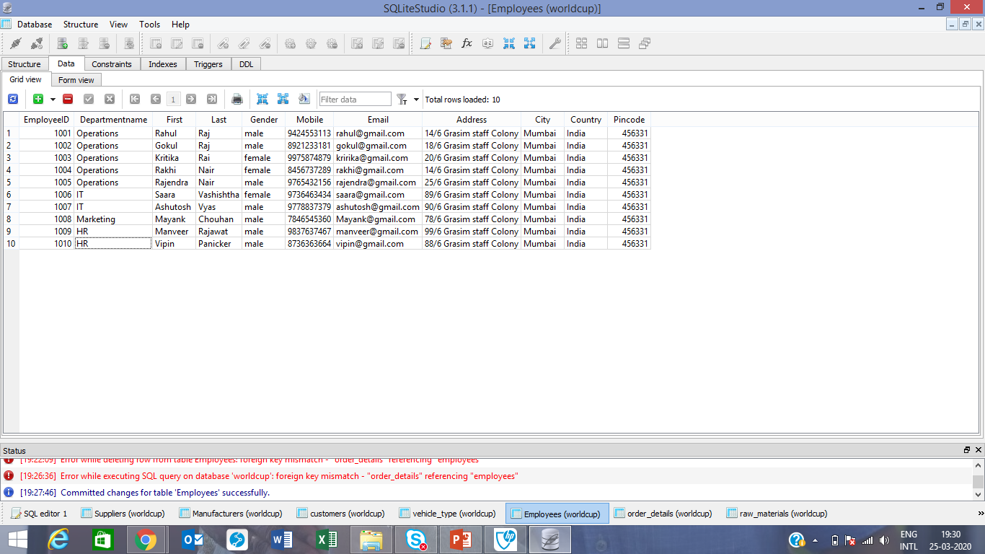
create table Employees(EmployeeID Integer Primary Key,
First Name Text Not Null,
Last Name Text Not Null,
Gender Text not null,
Mobile Number integer not null,
Email Not null unique,
Address Not Null,
City Not Null,
Country Not null,
Pincode integer(6) not null unique,
check(Gender in ('male','female','male')))
Insert into Employees values()
Alter table employees add Departmentname text

Slide 11
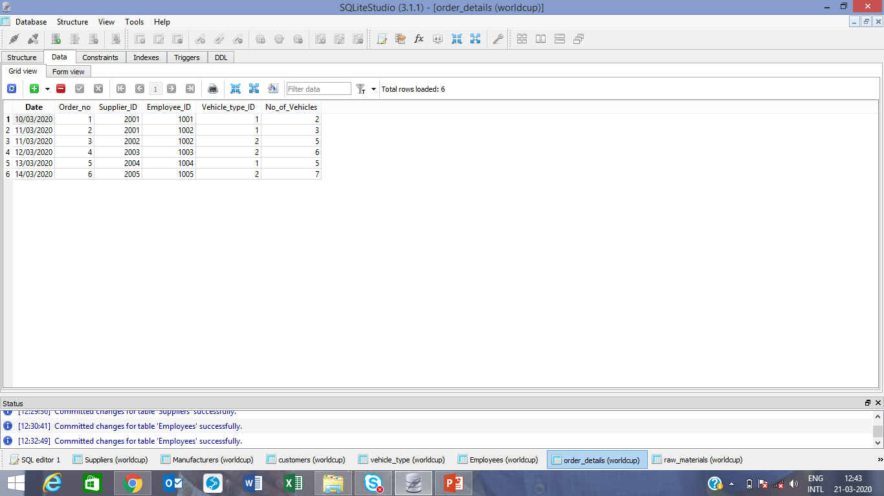
Create table order_details
(Date text not null,
Order_no integer not null,
Supplier_ID integer not null,
Employee_ID integer not null,
Vehicle_type_ID integer not null,
No_of_Vehicles integer not null,
Foreign key(Supplier_ID) references Suppliers(SupplierID),
foreign key(Employee_ID) references employees(employee),
foreign key(Vehicle_type_ID) references vehicle_type(Vehicle_type_ID));
insert into order_details
values('10/03/2020','001','2001','1001','1','2'),('11/03/2020','002','2001','1002','1','3'),('11/03/2020','003','2002','1002','2','5'),('12/03/2020','004','2003','1003','2','6'),
('13/03/2020','005','2004','1004','1','5'),('14/03/2020','006','2005','1005','2','7')

Slide 12
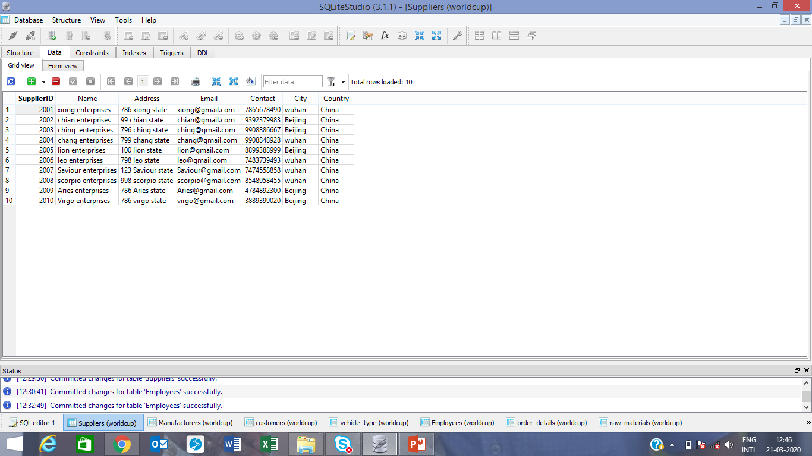
create table Suppliers
(SupplierID integer primary key ,
Name text not null,
Address not null,
Email not null unique,
Contact integer not null,
City text not null,
Country text not null)
Insert Into Suppliers
values('2001','xiong enterprises','786 xiong state','xiong@gmail.com','7865678490','wuhan','China'),
('2002','chian enterprises','99 chian state','chian@gmail.com','9392379983','Beijing','China'),
('2003','ching enterprises','796 ching state','ching@gmail.com','9908886667','Beijing','China'),
('2004','chang enterprises','799 chang state','chang@gmail.com','9908848928','wuhan','China') …………………………………………….

Slide 13
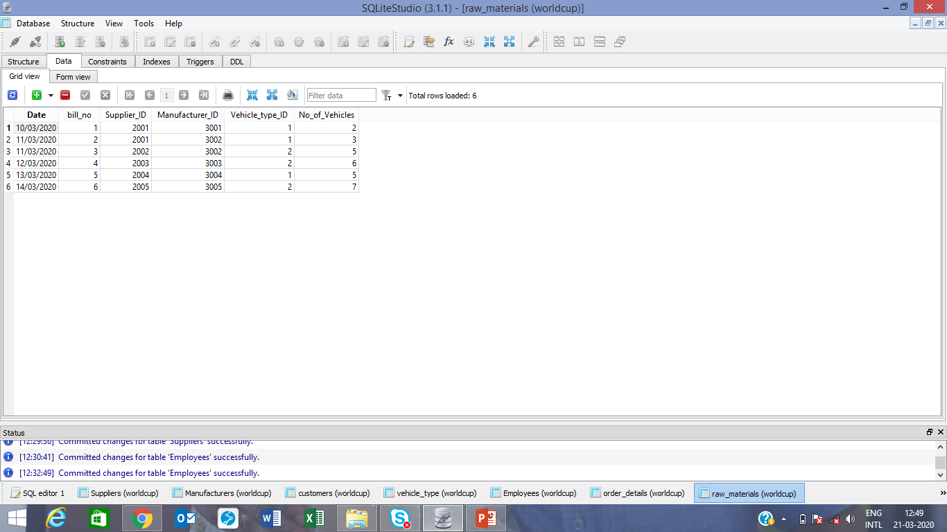
create table raw_materials
(Date text not null,
bill_no integer primary key not null,
Supplier_ID integer not null,
Manufacturer_ID integer not null,
Vehicle_type_ID integer not null,
No_of_Vehicles integer not null,Foreign key(Supplier_ID) references Suppliers(SupplierID),
foreign key(Manufacturer_ID) references manufacturers(ManufacturerID),
foreign key(Vehicle_type_ID) references vehicle_type(Vehicle_type_ID))
insert into raw_materials
values('10/03/2020','01','2001','3001','1','2'),('11/03/2020','02','2001','3002','1','3'),('11/03/2020','03','2002','3002','2','5'),('12/03/2020','04','2003','3003','2','6'),
('13/03/2020','05','2004','3004','1','5'),('14/03/2020','06','2005','3005','2','7')

Slide 14
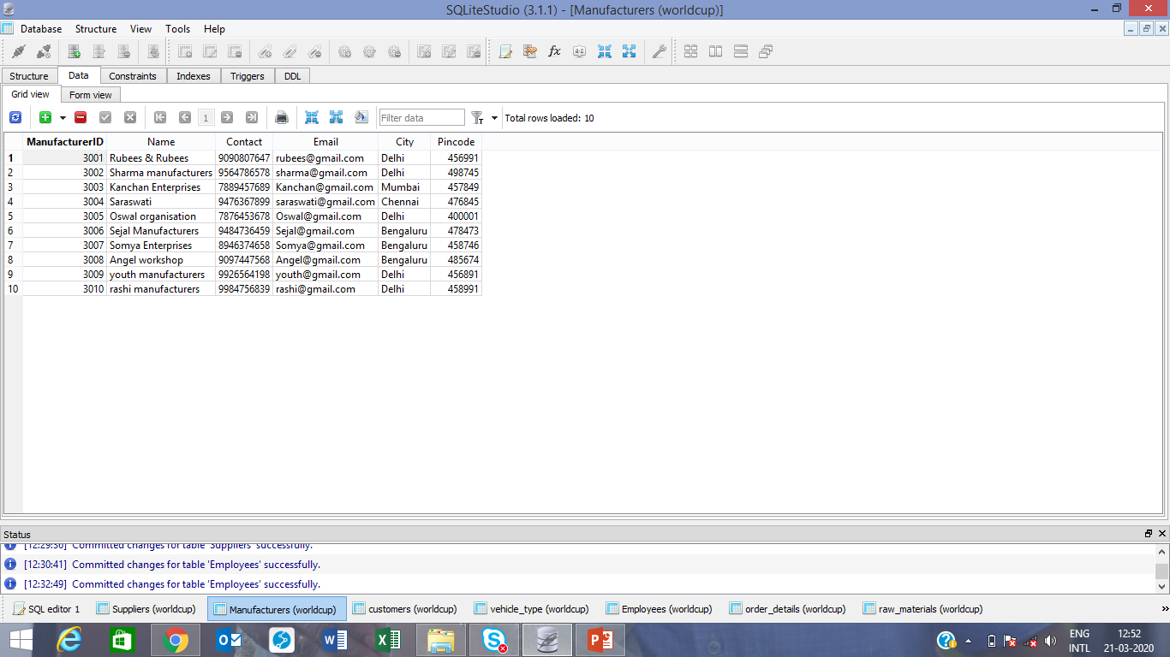
Create table Manufacturers
(ManufacturerID integer primary key not null,
Name text not null,
Contact No integer not null,
Email text not null unique,
City text not null,
Pincode integer not null Unique)
Insert into manufacturers
values('3001','Rubees & Rubees','9090807647','rubees@gmail.com','Delhi','456991'),('3002','Sharma manufacturers','9564786578','sharma@gmail.com','Delhi','498745'),('3003','KanchanEnterprises','7889457689','Kanchan@gmail.com','Mumbai','457849'),('3004','Saraswati','9476367899','saraswati@gmail.com','Chennai','476845’)………………………………………………..

Slide 15
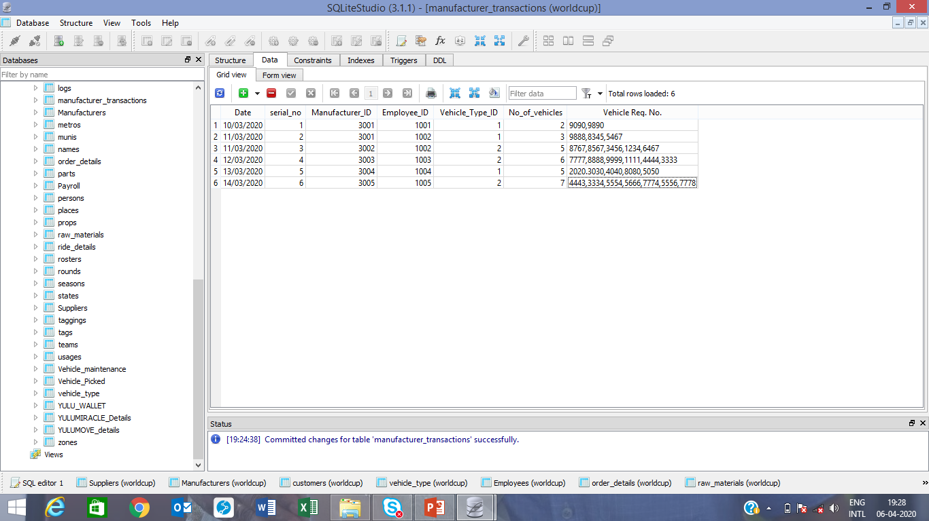
create table manufacturer_transactions
(Date text not null,
serial_no integer primary key not null,
Manufacturer_ID integer not null,
Employee_ID integer not null,
Vehicle_Type_ID integer not null,
No_of_vehicles integer not null,
Vehicle Reg.No. Integer not null,
Foreign key(manufacturer_ID) references MAnufacturers(manufacturerID),
foreign key(Employee_ID) references employees(employeeID),
foreign key(Vehicle_type_ID) references vehicle_type(Vehicle_type_ID));
insert into manufacturer_transactions
values('10/03/2020','01','3001','1001','1','2‘,’9090,9890’)………………………………

Slide 16
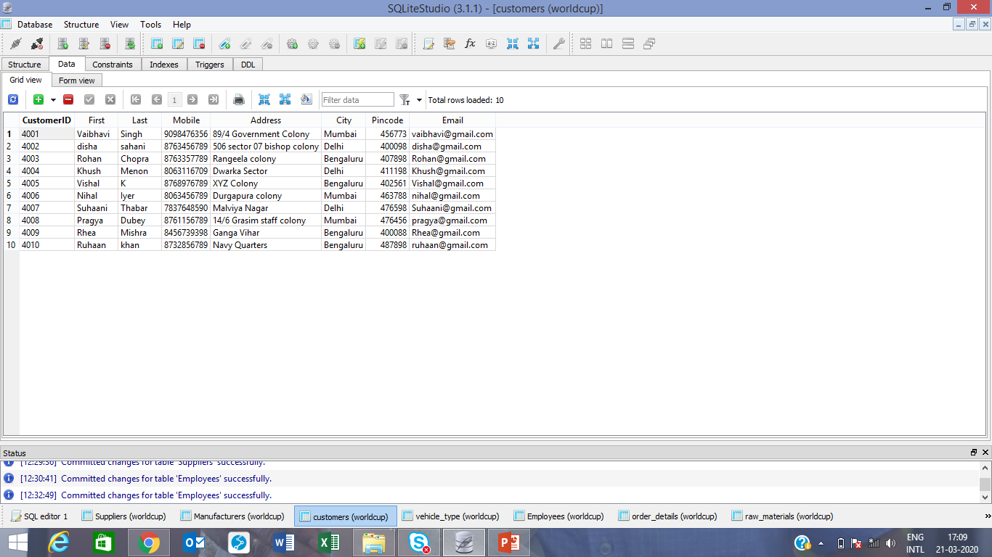
Create table customers
(CustomerID integer primary key not null,
First Name Text Not null,
Last Name Text Not null,
Mobile Integer not null,
Address text not null,
City text not null,
Pincode integer not null unique,
Email text not null unique)
insert into customers
values('4001','Vaibhavi','Singh','9098476356','89/4 Government Colony','Mumbai','456773','vaibhavi@gmail.com'),
('4002','disha','sahani','8763456789','506 sector 07 bishop colony','Delhi','400098','disha@gmail.com'),
('4003','Rohan','Chopra','8763357789','Rangeela colony','Bengaluru','407898','Rohan@gmail.com'),…………………………………………………………………………….

Slide 17
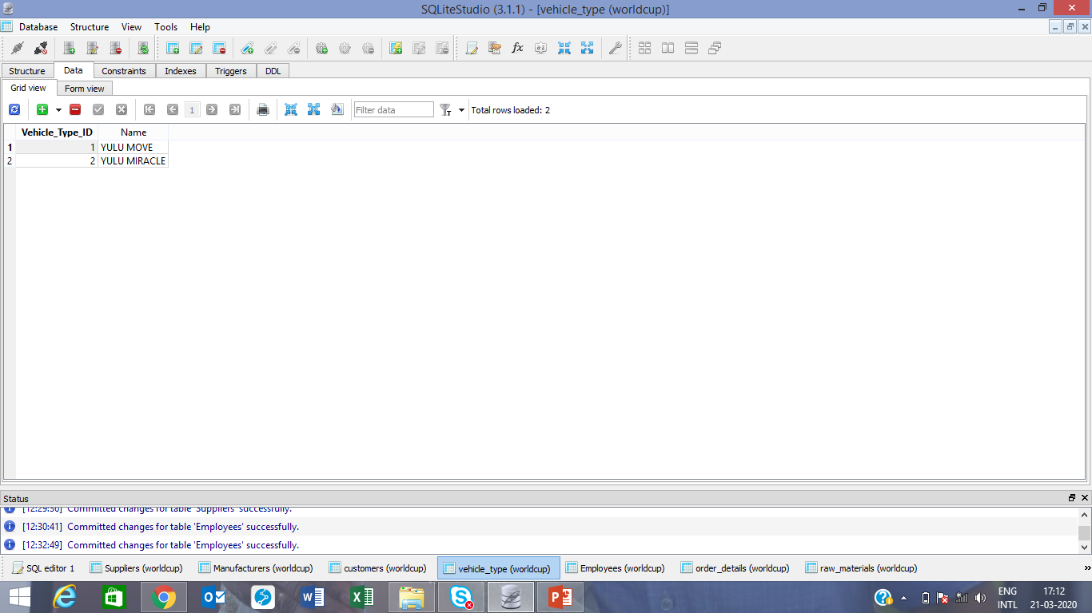
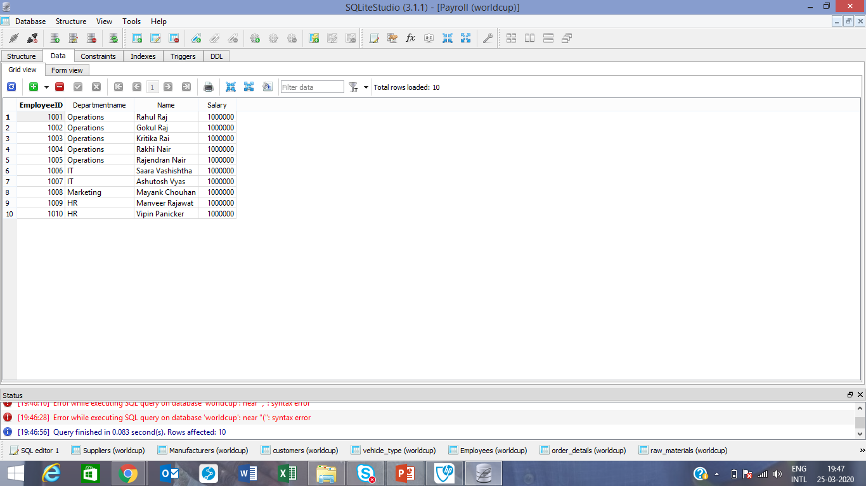
Create table vehicle_type
(Vehicle_Type_ID Integer primary key Not Null,
Name text not null)
insert into vehicle_type
values ('1','YULU MOVE'),('2','YULU MIRACLE')
Create table Payroll
(EmployeeID integer,
Departmentname text,
Name text,
Salary integer,foreign key(EmployeeID) references employees(employeeID))
Insert into Payroll
Values('1001','Operations','Rahul Raj','1000000'),
('1002','Operations','Gokul Raj','1000000'),('1003','Operations','Kritika Rai','1000000'),('1004','Operations','Rakhi Nair','1000000'),('1005','Operations','Rajendran Nair','1000000')

Slide 18
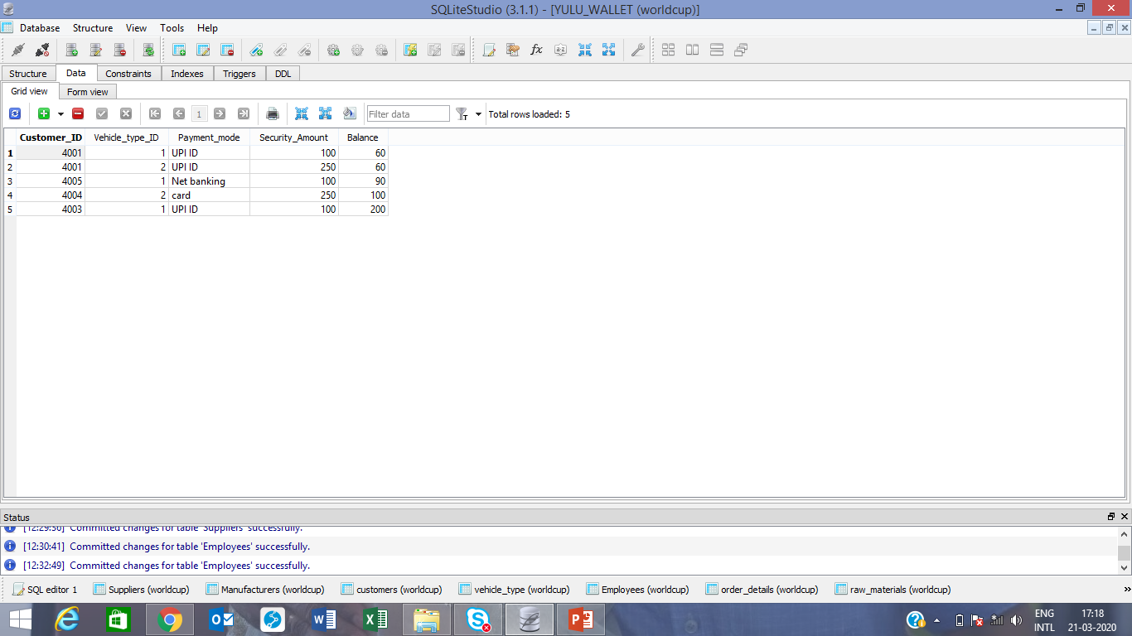
create table YULU_WALLET
(Customer_ID integer not null,
Vehicle_type_ID integer not null,
Payment_mode text not null,
Security_Amount integer not null,
Balance integer not null,foreign key(Customer_ID) references customers(CustomerID),foreign key(vehicle_type_ID) references vehicle_type(vehicle_type_ID))
insert into YULU_WALLET
values('4001','1','UPI ID','100','60'),('4001','2','UPI ID','250','60'),('4005','1','Net banking','100','90'),('4004','2','card','250','100'),('4003','1','UPI ID','100','200')

Slide 19
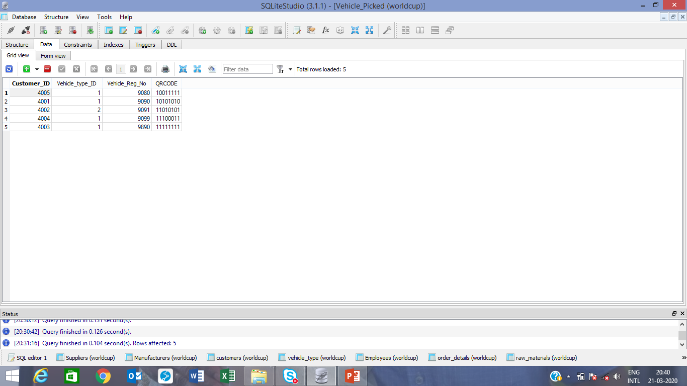
Create table Vehicle_Picked
(Customer_ID integer not null unique,
Vehicle_type_ID integer not null,
Vehicle_Reg_No integer primary key not null unique,
QRCODE integer not null unique,foreign key(Customer_ID) references customers(CustomerID),foreign key(vehicle_type_ID) references vehicle_type(vehicle_type_ID))
insert into Vehicle_Picked
values('4001','1','9090','10101010'),('4002','2','9091','11010101'),('4003','1','9890','11111111'),('4004','1','9099','11100011'),('4005','1','9080','10011111')

Slide 20
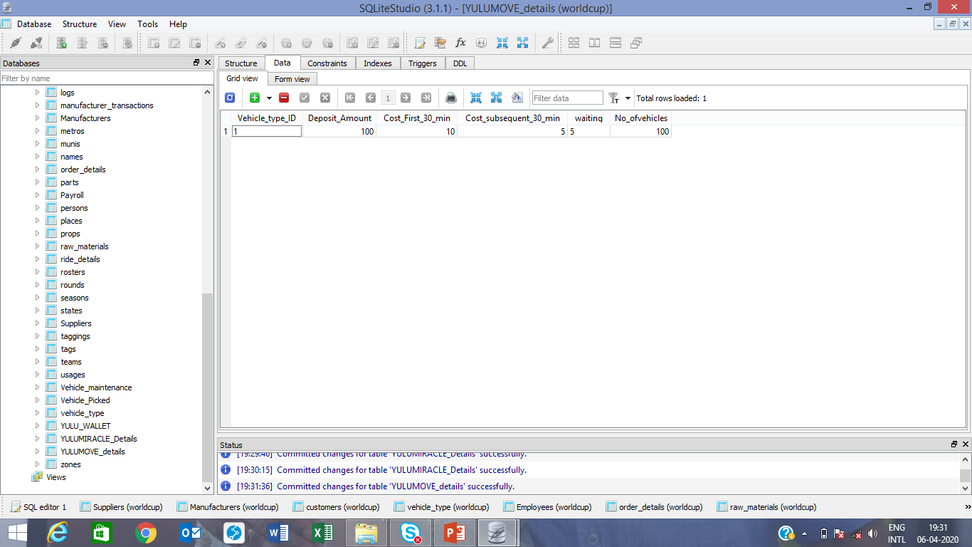

Create table YULUMOVE_details
(Vehicle_type_ID integer not null,
Deposit_Amount integer not null,
Cost_First_30_min integer not null,Cost_subsequent_30_min integer not null,waiting charges_every_30_min integer not null,No_of vehicles integer not null, foreign key(vehicle_type_ID) references vehicle_type(vehicle_type_ID))
insert into YULUMOVE_details
values('100','10','5','5’,‘100’)
create table YULUMIRACLE_Details
(Vehicle_type_ID integer not null,
Deposit_Amount integer not null,Unlock_charges,Subsequent_10min_charges integer not null,waiting_charges integer not null,No_ofvehicles integer not null, foreign key(vehicle_type_ID) references vehicle_type(vehicle_type_ID))
insert into YULUMIRACLE_details
values('250','10','10','5‘,’500’)

Slide 21
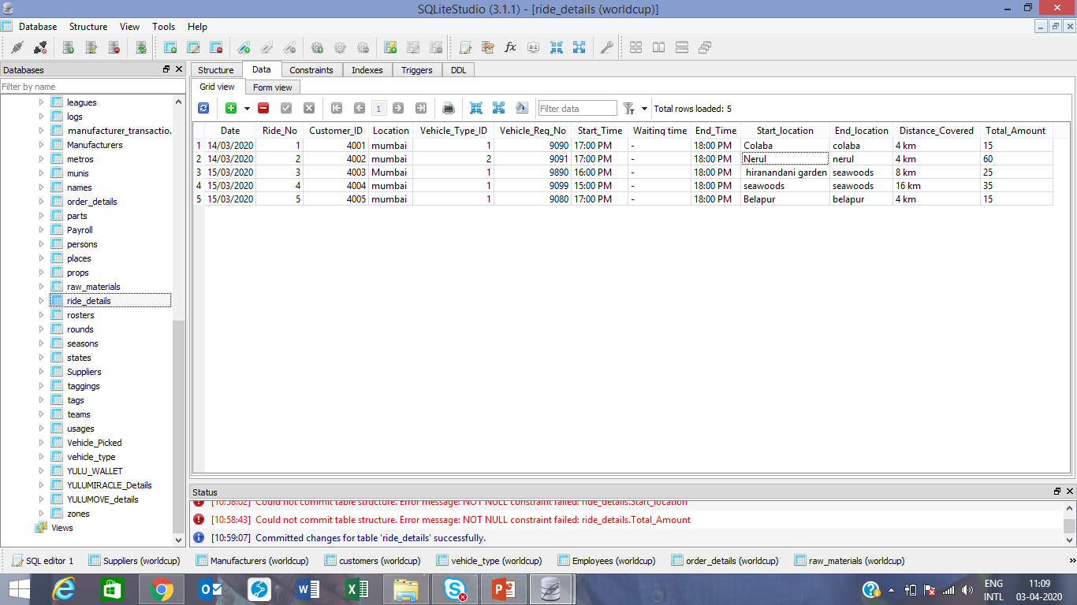
create table ride_details
(Date text not null,Ride_No integer not null,Customer_ID integer not null,Location text not null,Vehicle_Type_ID integer not null,Vehicle_Reg_No integer not null,Start_Time integer not null,Waiting Time Integer Not Null,End_Time integer not null,Start_Location Text not null,End_Location Text not null,Distance_Covered integer not null,Amount integer,
foreign key(Vehicle_type_ID) references vehicle_type(Vehicle_type_ID),foreign key(Customer_ID) references customers(customerID),foreign key(Vehicle_Reg_no) references vehicle_picked(Vehicle_reg_no))
insert into ride_details
values('14/03/2020', '01','4001',‘Mumbai','1','9090','17:00 PM','18:00 PM',’colaba,’colaba’,'4 km‘,’15’),………………………………………………………

Slide 22
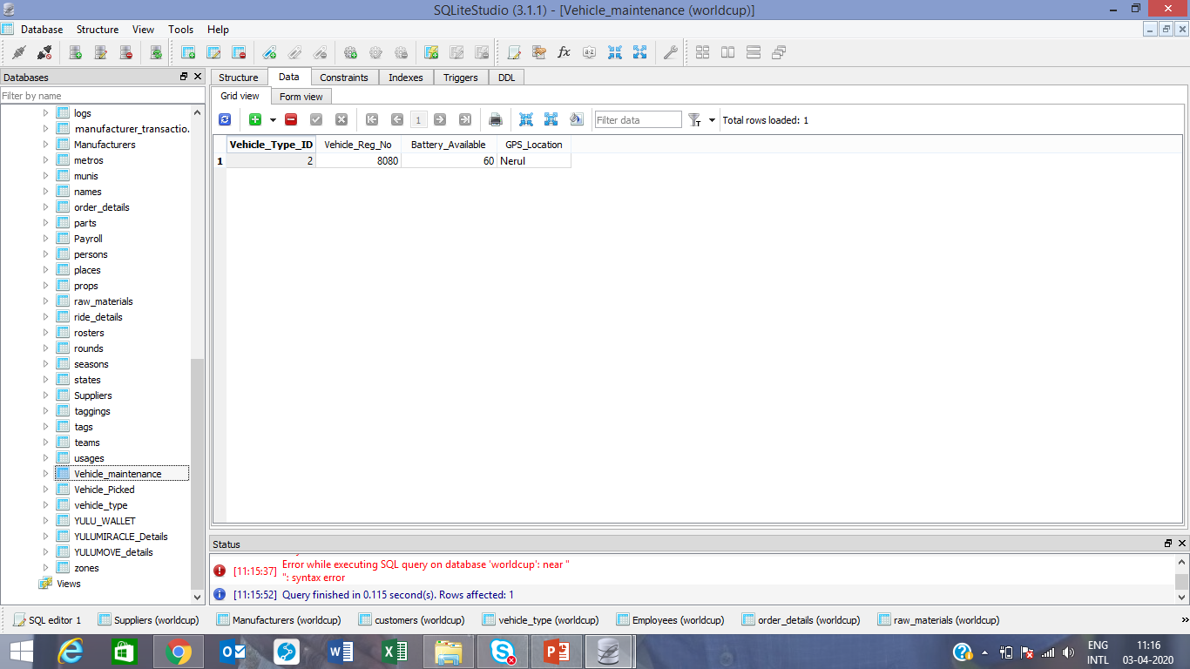
Create table Vehicle_maintenance
(Vehicle_Type_ID integer ,
Vehicle_Reg_No integer,
Battery_Available integer,
GPS_Location text)
insert into Vehicle_maintenance
values('2','8080','60','Nerul')

Slide 23
THANK YOU…..!!!

